Slide 1
“Covid-19 Helper”
Name Vivek Pundkar
Roll no 77
GR no 11910860
Batch C3
--------------------------------------------------------Guided by : Prof. Sunil Tayde

Slide 2
Content
INTRODUCTION
COVID-19 HELPER
REQUIREMENT
TIMELINE
RESULTS
CONCLUSION
REFERENCES

Slide 3
Introduction
During the pandemic, the increasing number of covid patients and lack of medical facilities, resulted in chaos in the medical services.
As a result of many patients are unable to find proper hospital facilities in a quick period.
So, basically AIM is to deploy a website with covid-19-tracker and a hospital system wherein;
Covid tracker would be used in general to keep track of pandemic situations around the globe.
Hospital management can enter available beds, oxygen, ventilator, and other basic hospital information like address, distance, and type of hospital.

Slide 4
Covid-19 Helper?
COVID-19 TRACKER
HOSPITAL
HOSPITAL LOGIN
SERVICES

Slide 5


REQUIREMENT
Technology used: HTML, CSS, JS and firebase
Software Requirements: VS Code, Firestore, and Google Maps
Dependencies: Material-UI/icons, bootstrap, react-router-dom, RWebShare
disease.sh; leafletjs.com; apisetu.gov.in

Slide 6
Timeline
Finalizing problem statement
Looking for available systems
Working on tracker part
Deploying covid tracker
Designing administrator pages
Error solving of tracker part
Administrator login part
Hospital management
Backend work and error solving
1
2
3-4
5
6
7
8
9-11
12-13

Slide 7
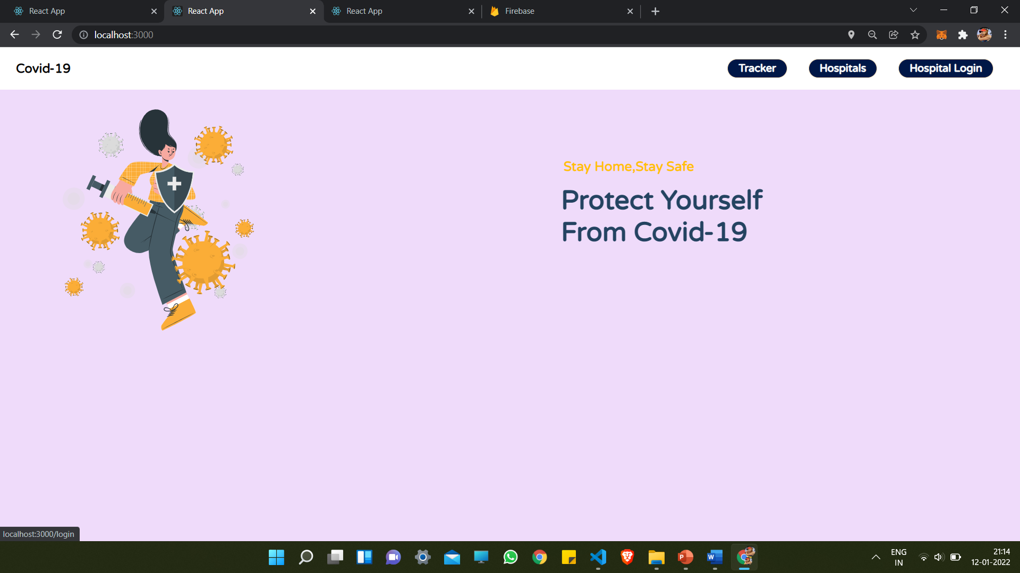
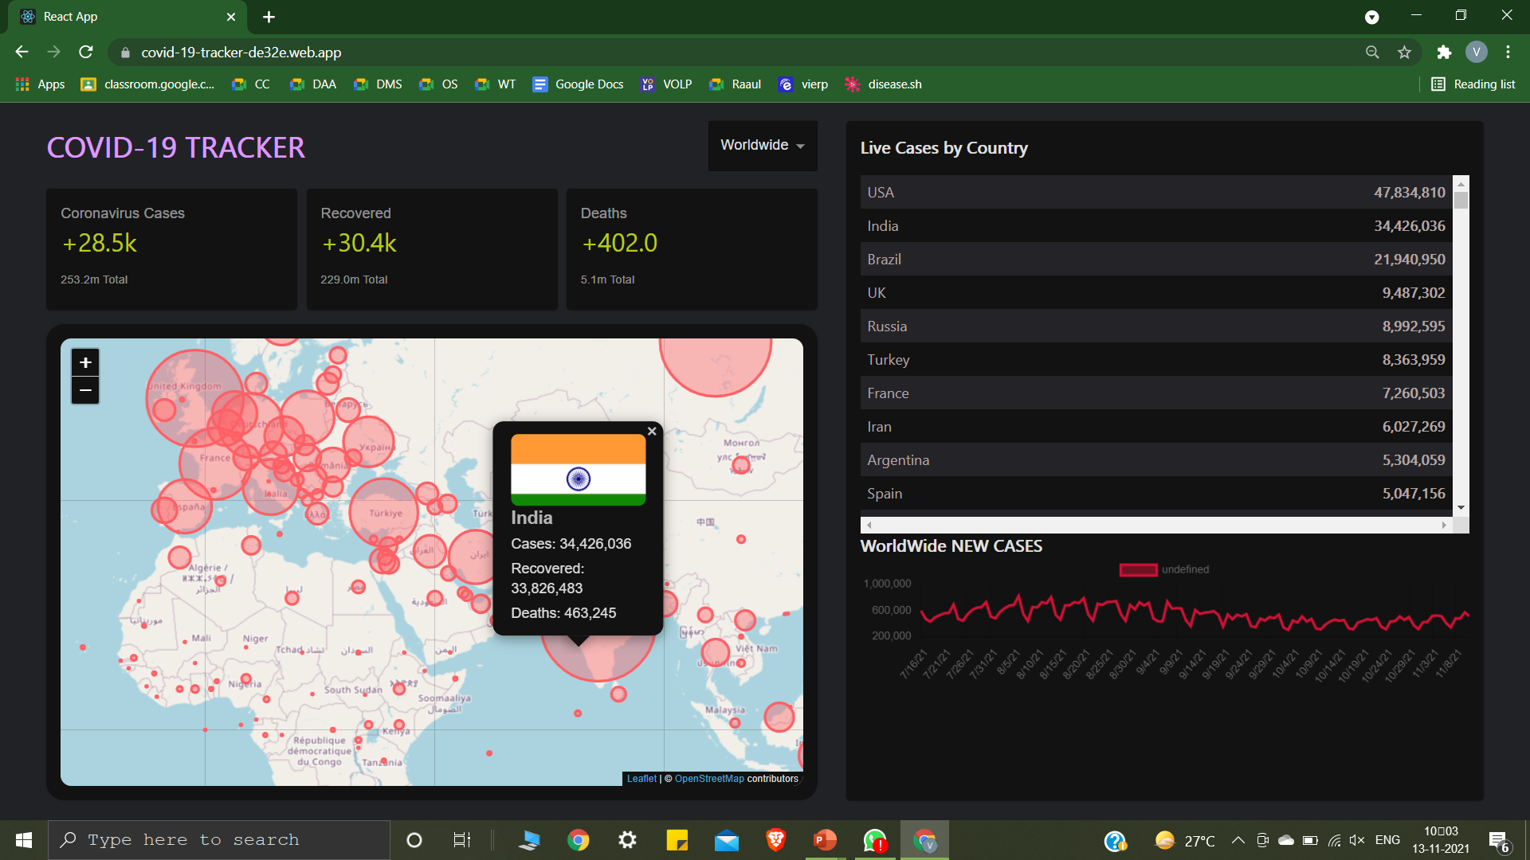
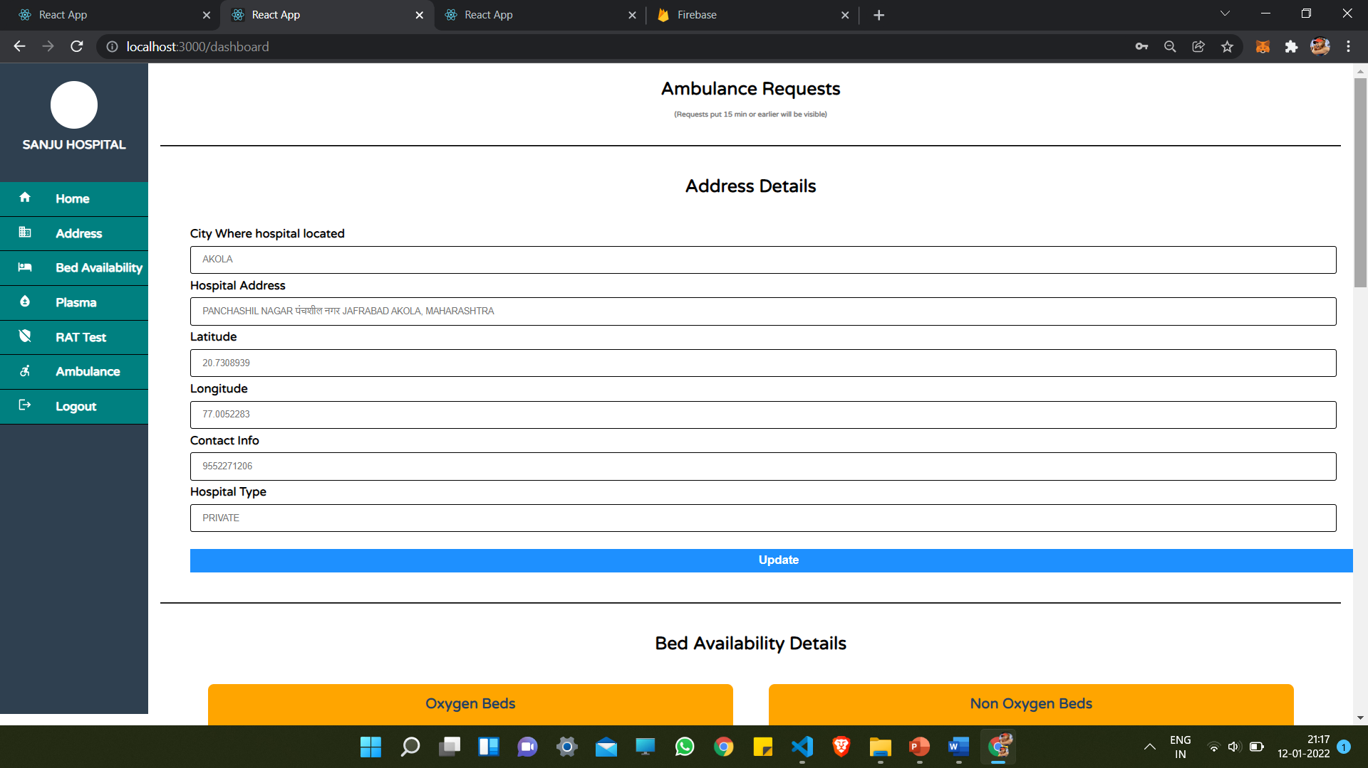
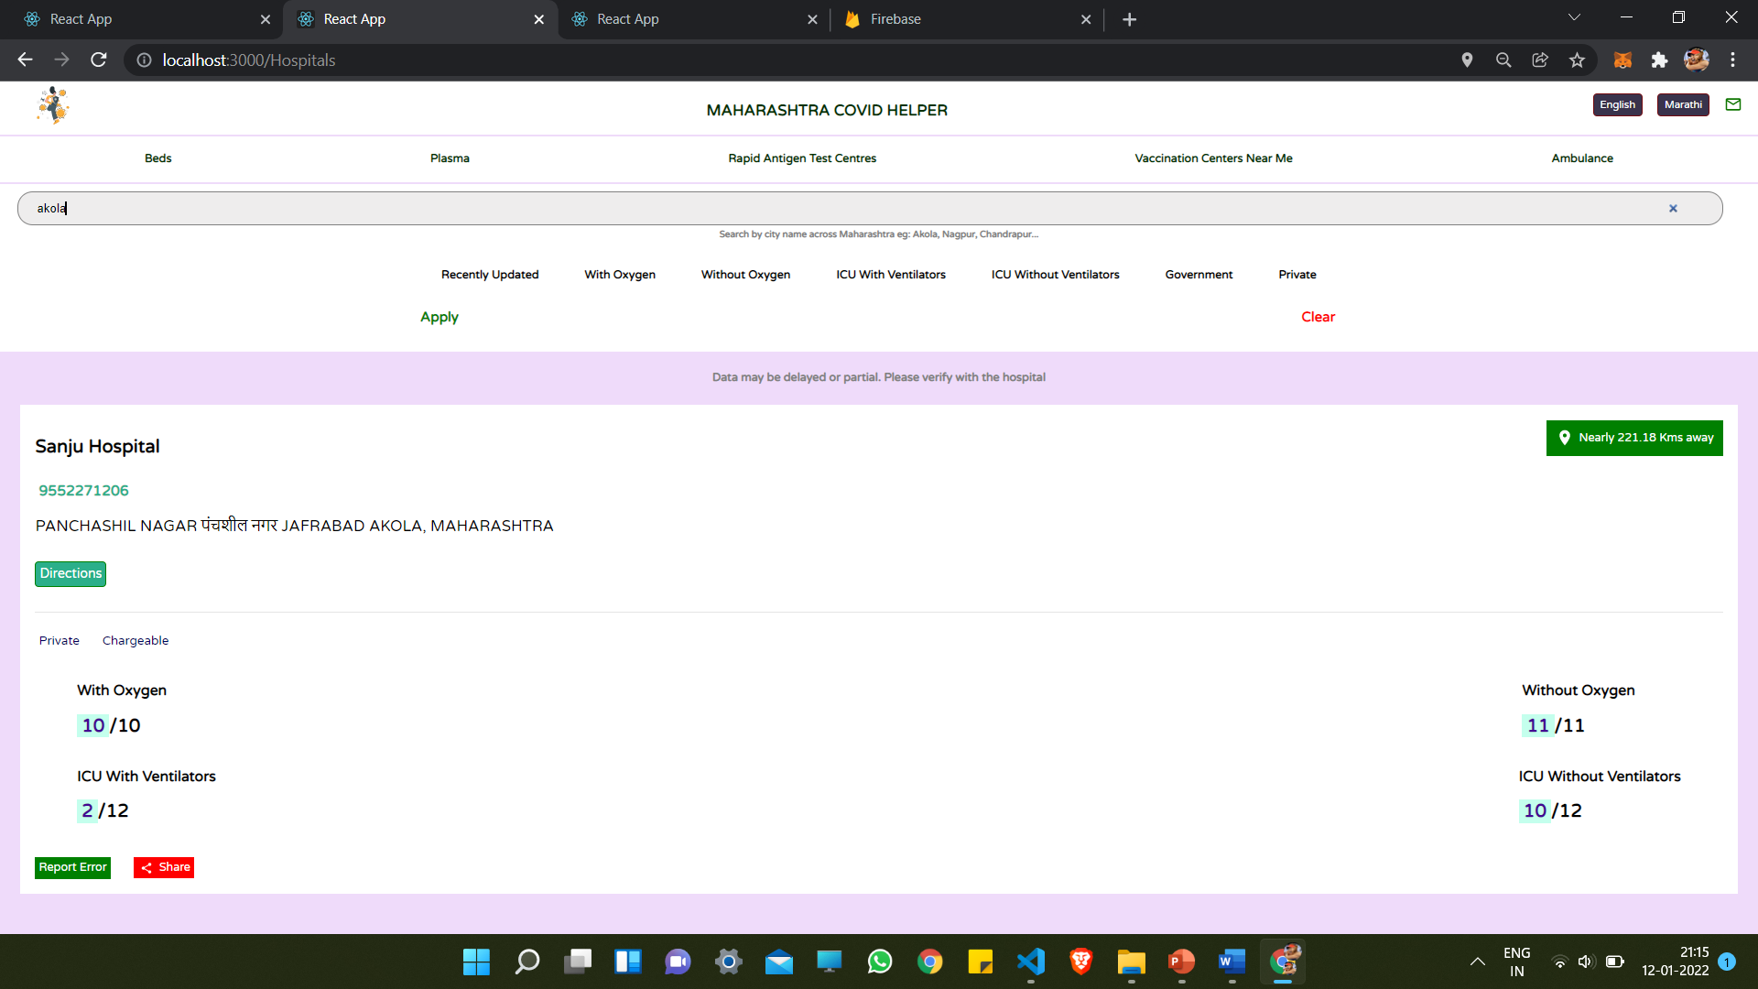
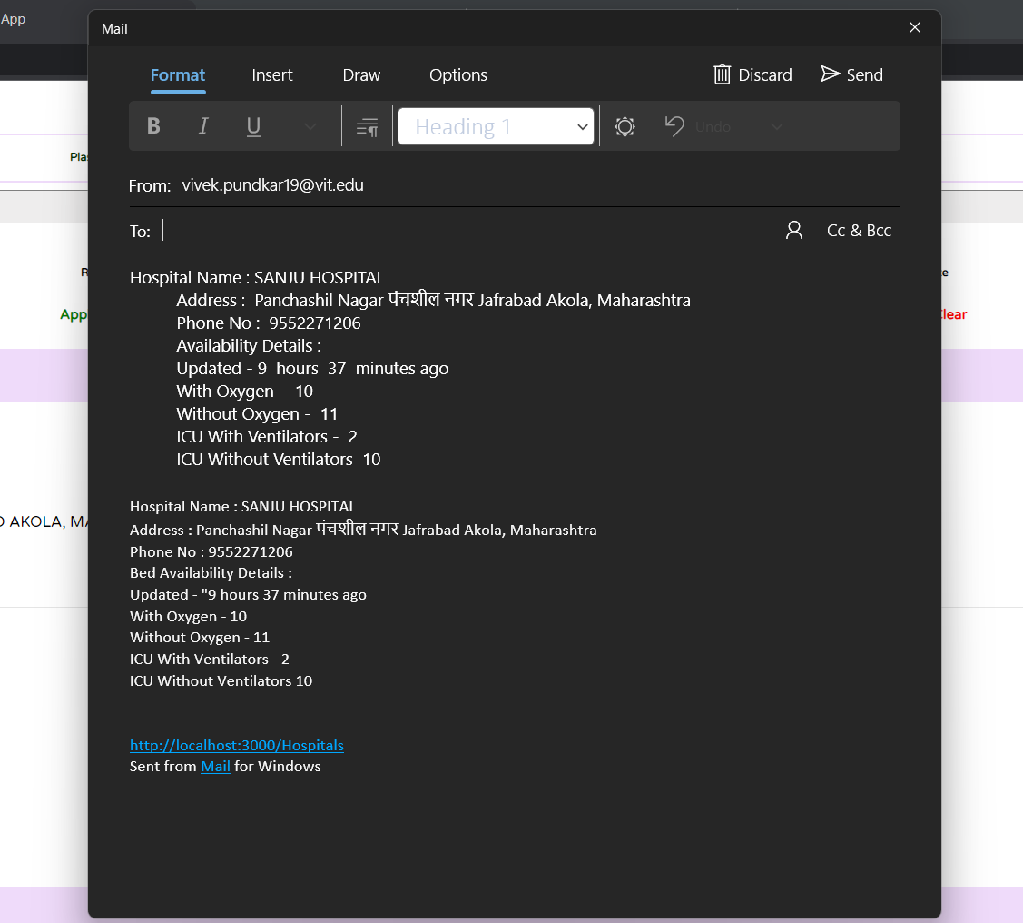
Result

Slide 8

Conclusion
Deployed a covid helper (react web app) containing tracker and hospital modules on firebase, this aim is achieved successfully. Administrators can update hospital-related information, which is dynamically visible to Users. Users can change language (English/Marathi) and also get track of the closest vaccination center around the current location
Deployed link: tracker- https://helper-a77d7.web.app/

Slide 9
REFERENCES
“A hospital resource and patient management system based on real-time data capture and intelligent decision making” Author(s): Musa, A. Lancashire Bus. Sch., Univ. of Central Lancashire, Preston, UK Yusuf, Y, Meckel.M. Systems and Informatics (ICSAI), 2012 International Conference
“Developing Effective Hospital Management Information Systems: A Technology Ecosystem Perspective”. DATE OF SUBMISSION: 5 October 2014 PREPARED BY: Dr Christopher Bain MBBS, Master Info. Tech Student No: 10054499
https://apisetu.gov.in/api/cowin
https://mui.com/
https://www.npmjs.com/
https://disease.sh/

Slide 10


